Slide 1

Codergirl – Frontend
Unit 2 - Class 15
Jan 27, 2021
Notes:
1

Slide 2
Agenda
Consuming a service
SASS
Section 28 – Unit Testing.
Studio – practice unit testing.
Project requirements
https://docs.google.com/document/d/1W3o35917j_T1qd8UlKgAkLz-23d07x90ayhXoKsRb0o/edit
Notes:
2

Slide 3
Consuming a service
Notes:
http://api.weatherstack.com/current?access_key=04bd8fafbb30ee63c16f382a1d6aa404&units=f&query=63303
3

Slide 4
SASS
package.json
scss - https://www.digitalocean.com/community/tutorials/using-sass-with-the-angular-cli
https://netbasal.com/angular-cli-and-global-sass-variables-a1b92d8ca9b7
Notes:
4

Slide 5
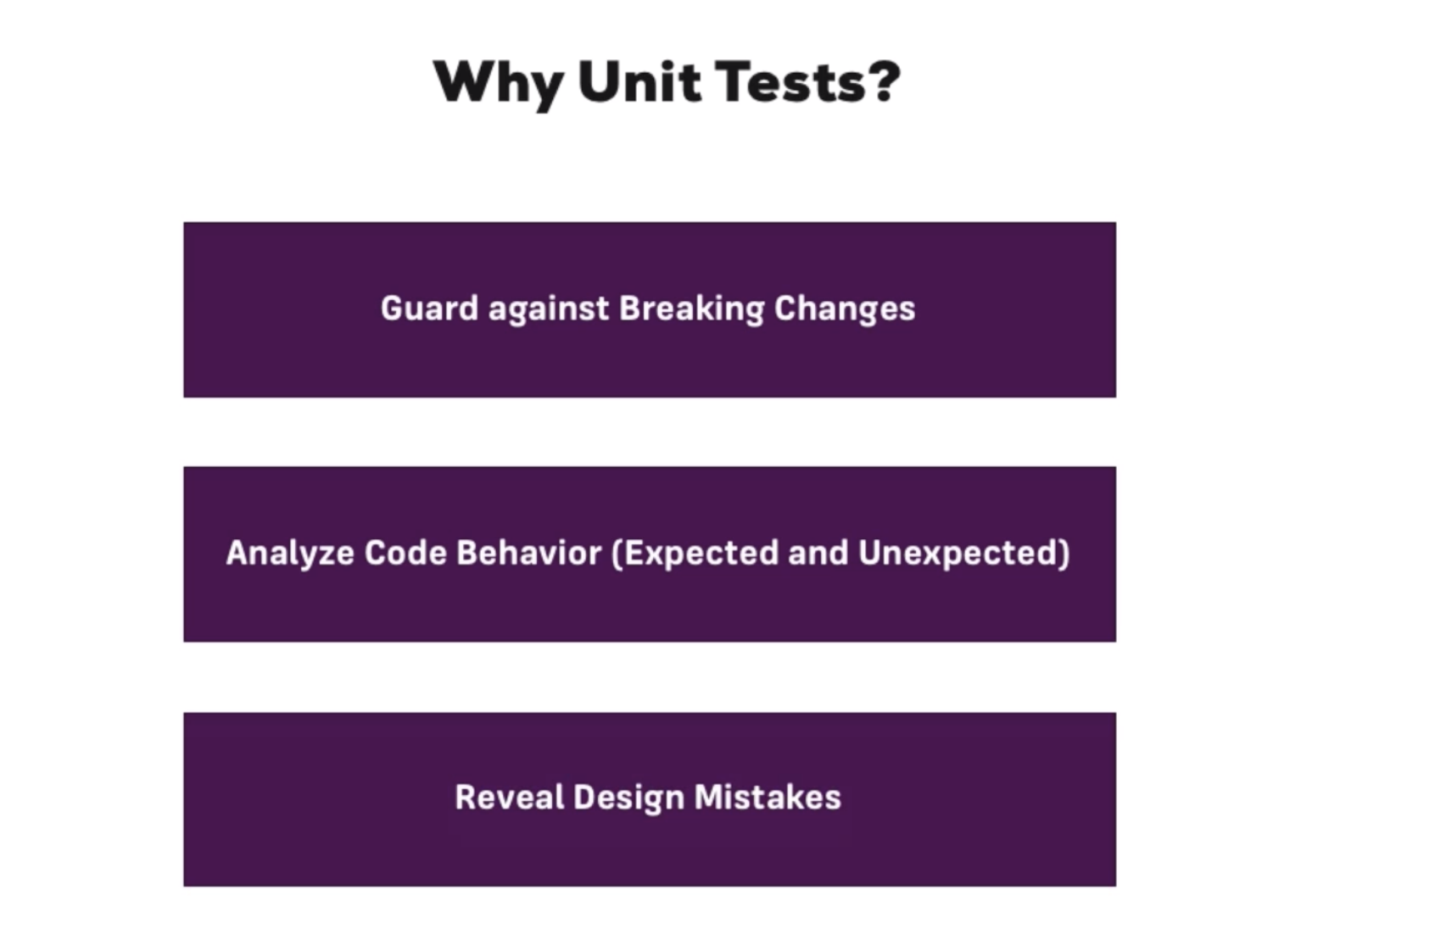
Http and Backend Integration
Notes:
5

Slide 6
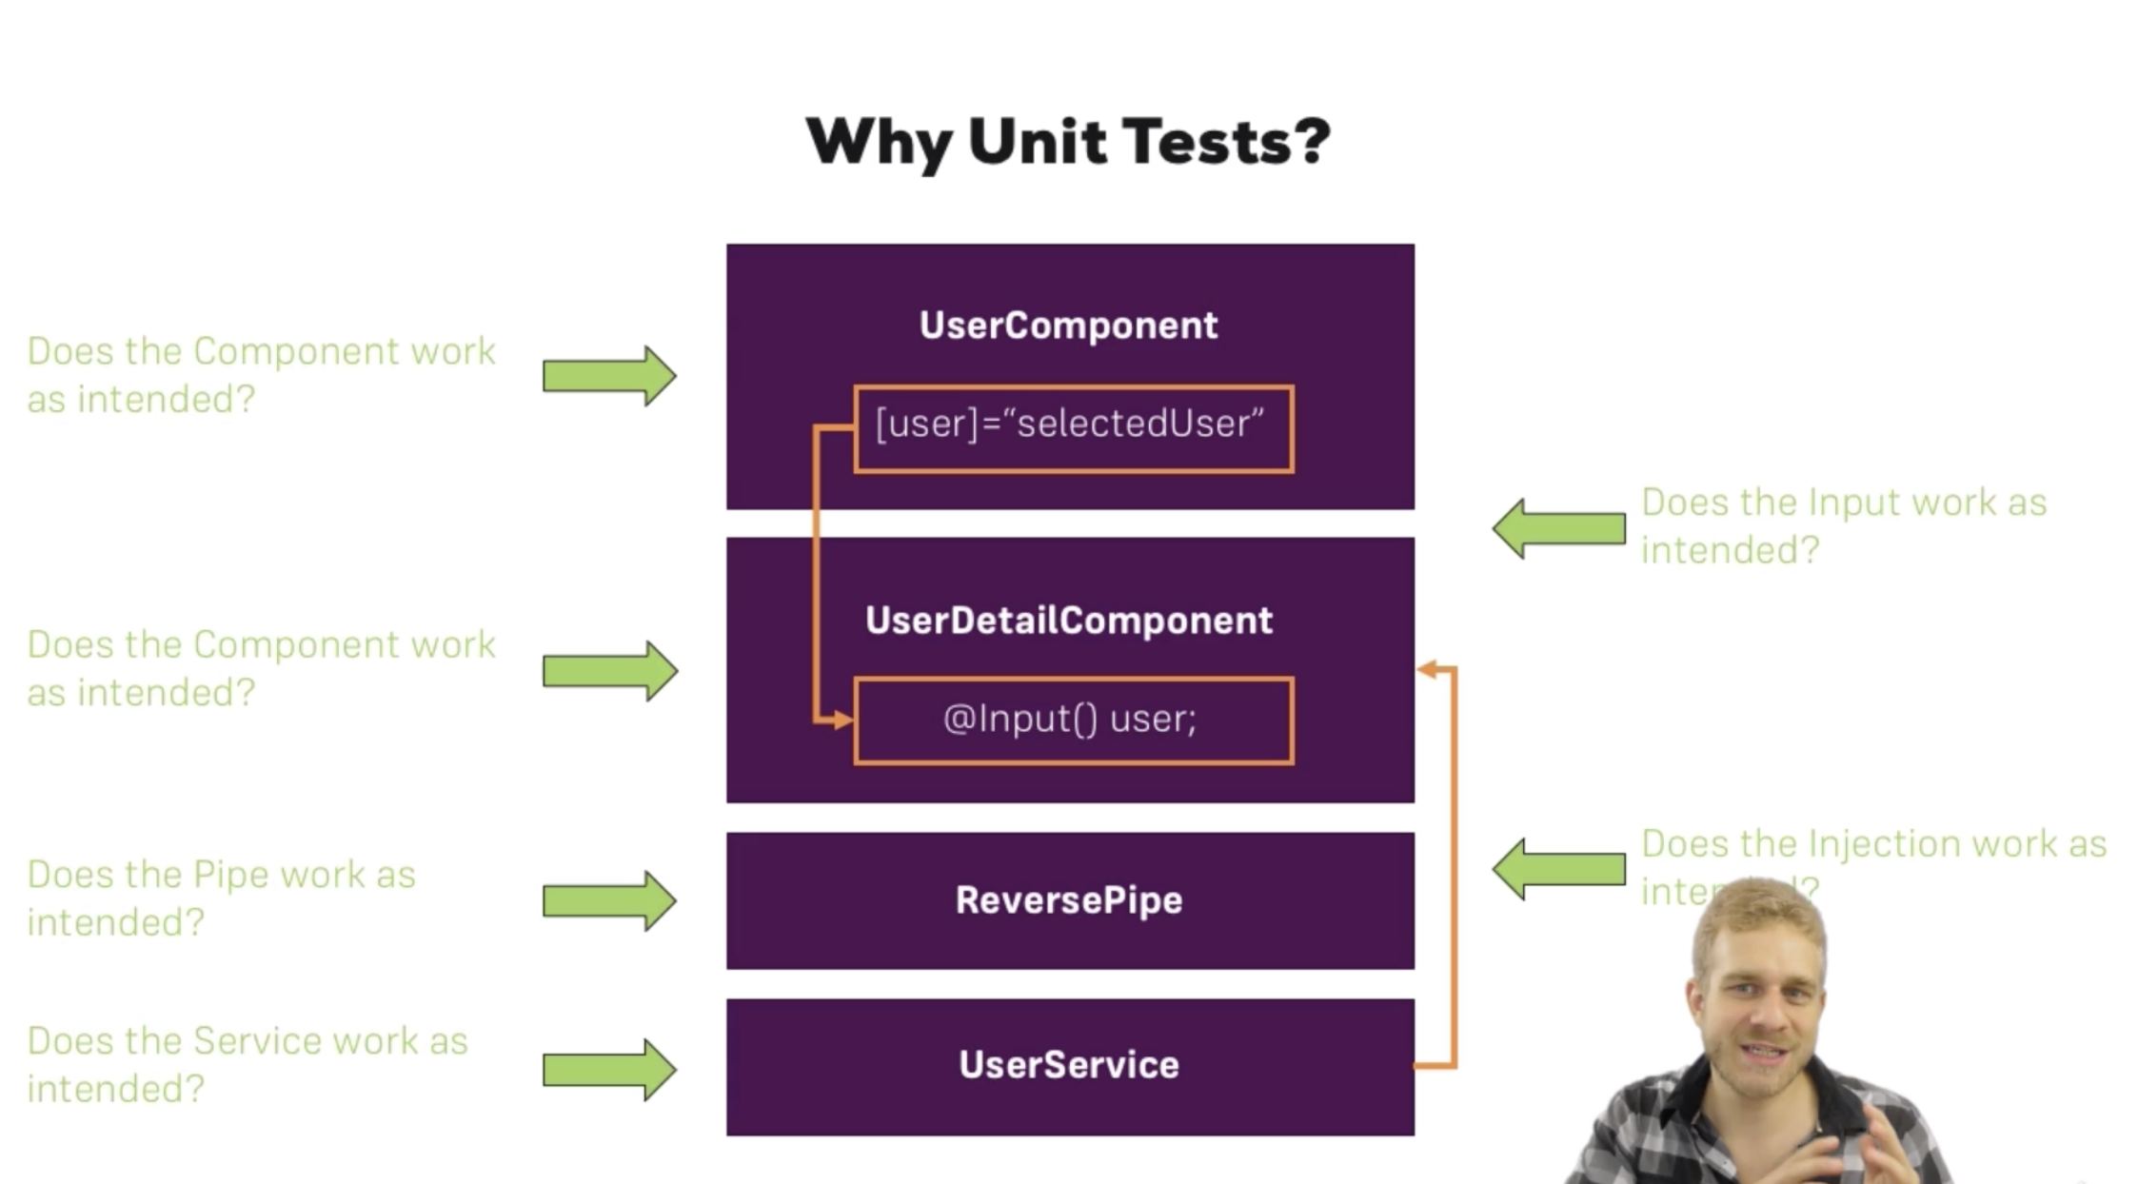
Http and Backend Integration
Notes:
6

Slide 7


UNIT TESTING RESOURCES
https://angular.io/guide/testing
The CLI takes care of Jasmine and Karma configuration for you.
The test file extension must be .spec.ts so that tooling can identify it as a file with tests (AKA, a spec file).
CI
https://jasmine.github.io/pages/getting_started.html
https://jasmine.github.io/tutorials/your_first_suite
https://semaphoreci.com/community/tutorials/testing-components-in-angular-2-with-jasmine
https://github.com/angular/angular-cli
Notes:
7

Slide 8
TEST UTILITIES
Need to get test utility setup via tutorial.
Test Runner – Karma.
Describe the to be tested unit.
Unit test- Each ‘it’ block is a test.
beforeEach() runs before each test.
Test logic – Angular app with app module and app component and runs in browser.
Testing environment is the test running it. We need to bootstrap our application. Setup app module and execute tests to what user sees.
Notes:
8

Slide 9
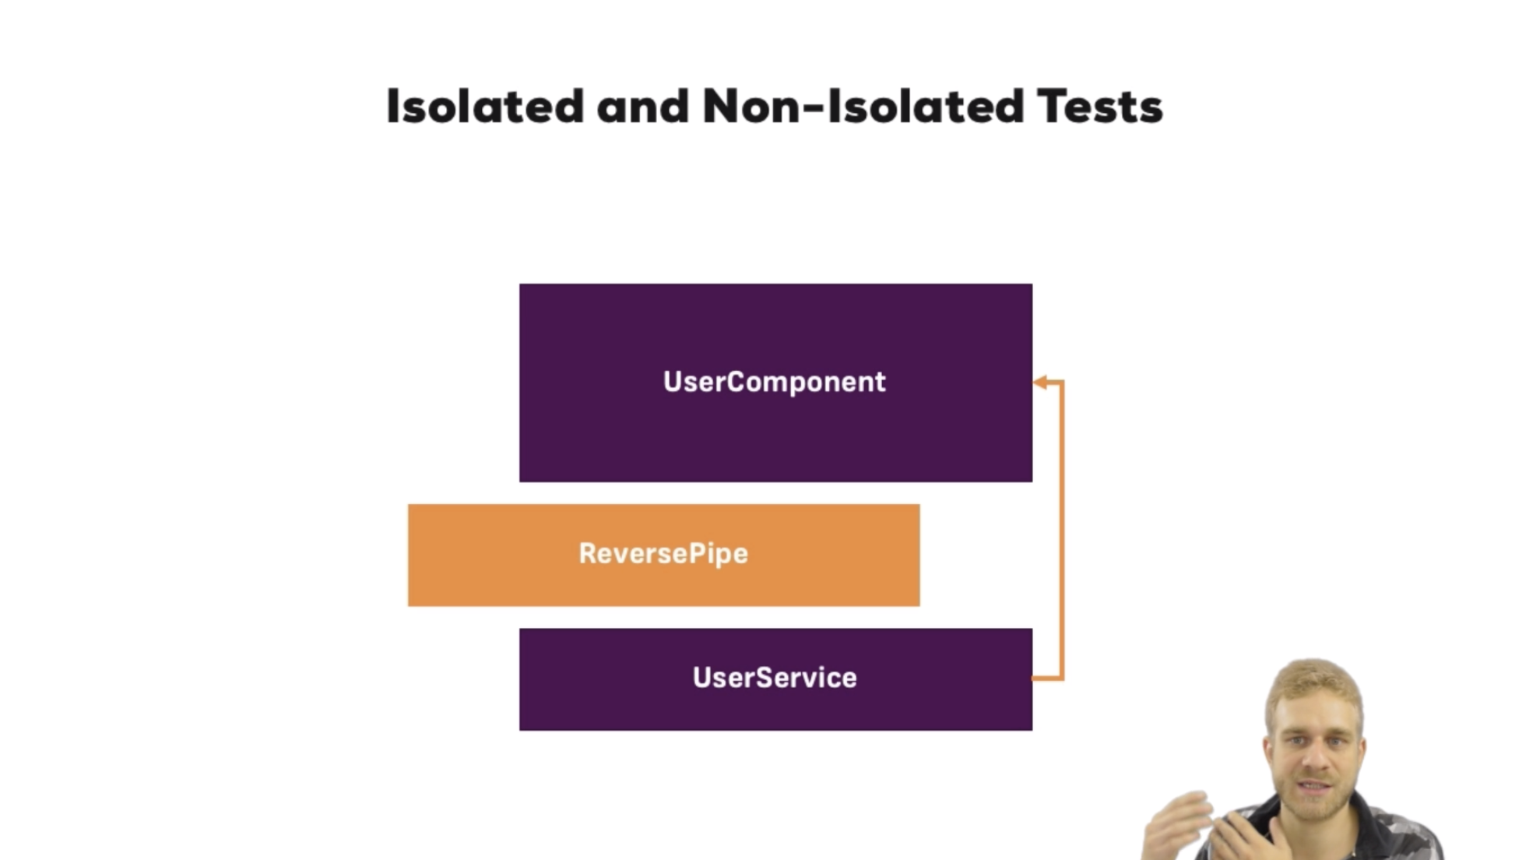
Notes:
Normal unit test for Util functions. Don’t need angular testing packages.
9

Slide 10
TESTING PIPE FUNCTION

Slide 11
TEST UTILITIES
Test for component created
Fixture holds created component – truthy means existent
debugElement lets us examine the component
expect is a testing package provided by testing package such as karma or Jasmine
Expect app to have a property of a title with a value of the existing title
detectChanges triggers change detection
We can expect certain elements such as h1 element and containing some specific text value
ng test will run the test cli
Notes:
11

Slide 12
CREATING UNIT TEST
Create a new component
ng g c user

Slide 13
CREATING UNIT TEST

Slide 14
CREATING USER SERVICE TEST

Slide 15
SIMULATING ASYNC TASKS
Notes:
Don’t want to call real service but fake it. Spy is used for that purpose. U have to pass the name of the method that u want to spy on. So when the method is called, instead of executing it, we need to return a dummy value instead. async creates the async testing environment in Angular. When stable waits for the environment is stable and mimics the real environment. fakeAsync allows us to get ready of when stable, use tick instead. In an aysn environment, finish all activity and get the data needed. So async with stable or fakeAsync with tick.

Slide 16
Questions?

Slide 17
Studio
Course Project – Unit Testing

